Slide 1


Geometric Distribution
The geometric distribution is a probability distribution that models the number of trials required to achieve the first success in a sequence of independent Bernoulli trials, where each trial has a constant probability of success.

Slide 2


Slide 3
The probability of getting a ”head” in a single toss of a biased coin is 0.3. The coin is tossed repeatedly till a ”head” is obtained. If the tosses are independent, then the probability of getting ”head” for the first time in the fifth toss is _______.
(GATE ECE 2016 Set 3)
0.072
0.72
0
1
Answer (a)

Slide 4
Geometric Distribution Example
Suppose a dice is repeatedly rolled until "3" is obtained.

Slide 5

Expectation and Variance of Geometric Distribution

Slide 6
Let the random variable X represent the number of times a fair coin needs to be tossed till two consecutive heads appear for the first time. The expectation of X is _______.
(GATE ECE 2015 Set 2)
5
6
10
11
Answer (b)

Slide 7
Passengers try repeatedly to get a seat reservation in any train running between two stations until they are successful. If there is a 40% chance of getting a reservation in any attempt by a passenger, then the average number of attempts that passengers need to make to get a seat reserved is __________.
(GATE ECE 2017 Set 2)
Answer 2.5

Slide 8
Binomial Distribution
Consider the scenario where we need to find the probability of the event of a even number showing up on die roll.

Slide 9

A random experiment consists of n Bernoulli trials such that
The trials are independent.
Each trial results in only two possible outcomes, labeled as “success” and “failure.”
The probability of a success in each trial, denoted as p, remains constant.
The random variable X that equals the number of trials that result in a success is a binomial random variable with parameters 0 < p < 1 and n = 1, 2, …. The probability mass function is given by-

Slide 10
Example
Suppose a biased coin comes up heads with probability 0.3 when tossed. The probability of seeing exactly 4 heads in 6 tosses is

Slide 11
Example – An airline sells 65 tickets for a plane with capacity of 60 passengers. This is done because it is possible for some people to not show up. The probability of a person not showing up for the flight is 0.1. All passengers behave independently. Find the probability of the event that the airline does not have to arrange separate tickets for excess people.

Slide 12
Example – Each sample of water has a 10% chance of containing a particular organic pollutant. Assume that the samples are independent with regard to the presence of the pollutant. Find the probability that in the next 18 samples, exactly 2 contain the pollutant

Slide 13
Expectation and Variance of Binomial Distribution
E[X] = np
$$\left.V[X]=np(1−p\right)$$

Slide 14
Example: A die is thrown repeatedly 36 times in all. Find E(X) and V (X) where X is the number of sixes obtained.

Slide 15
GATE CS 2021
For a given biased coin, the probability that the outcome of a toss is a head is 0.4. This coin is tossed 1,000 times. Let X denote the random variable whose value is the number of times that head appeared in these 1,000 tosses. The standard deviation of X (rounded to 2 decimal place) is _________ . (A) 15.49 (B) 50 (C) 16 (D) 10
Answer: (A)

Slide 16
A fair coin is tossed independently four times. The probability of the event ”The number of times heads show up is more than the number of times tails show up” is _________.
(GATE ECE 2010)
1/16
⅛
¼
5/16
Answer (d)

Slide 17
Poisson Distribution

Slide 18
Suppose an event can occur several times within a given unit of time. When the total number of occurrences of the event is unknown, we can think of it as a random variable. This random variable follows the Poisson Distribution.
The Poisson distribution is a limiting case of the Binomial distribution when the number of trials becomes very large and the probability of success is small.

Slide 19
Example- For the case of the thin copper wire, suppose that the number of flaws follows a Poisson distribution with a mean of 2.3 flaws per millimeter. Determine the probability of exactly two flaws in 2 millimeter of wire.

Slide 20
Mean, Variance and Standard Deviation –
Expectation[X] = $λ$
Var[X] = $λ$
Standard deviation [X] = $\sqrt{λ}$

Slide 21
Answer: 90 and 9

Slide 22
GATE CS 2013
Suppose p is the number of cars per minute passing through a certain road junction between 5 PM and 6 PM, and p has a Poisson distribution with mean 3. What is the probability of observing fewer than 3 cars during any given minute in this interval? (A) 8 / (2e³) (B) 9 / (2e³) (C) 17 / (2e³) (D) 26 / (2e³)
Answer: (C)

Slide 23
GATE-CS-2017 (Set 2)
If a random variable X has a Poisson distribution with mean 5, then the expression E[(X + 2)²] equals _____.
Note: This question appeared as Numerical Answer Type. (A) 54 (B) 55 (C) 56 (D) 57
Answer: (A)

Slide 24
ISRO CS 2009
If the pdf of a Poisson distribution is given by f(x) = $\frac{e^{−2}2^{x}}{x!}$ , then its mean is (A) 2^{x} (B) 2 (C) -2 (D) 1
Answer: (B)

Slide 25
GATE DA 2024
Consider the following statements:
The mean and variance of a Poisson random variable are equal.
For a standard normal random variable, the mean is zero and the variance is one. Which ONE of the following options is correct?
Both (i) and (ii) are true
(i) is true and (ii) is false
(ii) is true and (i) is false
Both (i) and (ii) are false
Answer: (A)

Slide 26
GATE DA 2024
The sample average of 50 data points is 40. The updated sample average after including a new data point taking the value of 142 is ______
Answer: (42)

Slide 27
Uniform Distribution
The Uniform Distribution, also known as the Rectangular Distribution, is a type of Continuous Probability Distribution.

Slide 28

It has a Continuous Random Variable X restricted to a finite interval [a, b] and it’s probability function f(x) has a constant density over this interval. The Uniform probability distribution function is defined as-

Slide 29
Cumulative Density Function –
As we know, the cumulative density function is nothing but the sum of probability of all events upto a certain value of x = t . In the Uniform distribution, the cumulative density function F(X) is given by-

Slide 30
Example : Let X be a uniform random variable with support [5,10].
Compute the probability P(7<X<9).

Slide 31
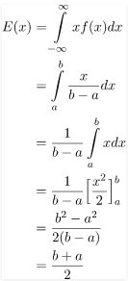
Expected or Mean Value – Using the basic definition of Expectation we get –

Slide 32

Variance- Using the formula for variance- V[X] = E[X²] – E[X]²
$$V(x)=\frac{{\left(b−a\right)}^{2}}{12}$$
Standard Deviation – By the basic definition of standard deviation,

Slide 33
Example – The current (in mA) measured in a piece of copper wire is known to follow a uniform distribution over the interval [0, 25]. Find the formula for the probability density function f(x) of the random variable X representing the current. Calculate the mean, variance, and standard deviation of the distribution and find the cumulative distribution function F(x)

Slide 34

GATE CS 2019
Answer: 0.8
Notes:
B^2-4ac>=0

Slide 35

GATE EC 2020
Answer: 0.3
Notes:
-10<Y<14 f(y) = 1/24

Slide 36
GATE CS 2014
Suppose you break a stick of unit length at a point chosen uniformly at random. Then the expected length of the shorter stick is ________ .
Answer: 0.25
Notes:
-10<Y<14 f(y) = 1/24

Slide 37
Exponential Distribution
Suppose we are posed with the question- How much time do we need to wait before a given event occurs? Since the time we need to wait is unknown, we can think of it as a Random Variable.

Slide 38
If the probability of the event happening in a given interval is proportional to the length of the interval, then the Random Variable has an exponential distribution. The support (set of values the Random Variable can take) of an Exponential Random Variable is the set of all positive real numbers.

Slide 39

Probability Density Function – For a positive real number $λ$ the probability density function of a Exponentially distributed Random variable is given by-

Slide 40
To check if the above function is a legitimate probability density function, we need to check if it’s integral over its support is 1.

Slide 41
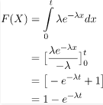
Cumulative Density Function –
As we know, the cumulative density function is nothing but the sum of probability of all events upto a certain value of x = t . In the Exponential distribution, the cumulative density function F(X) is given by-

Slide 42
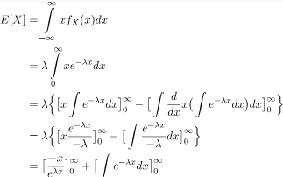
Expected Value –
To find out the expected value, we simply multiply the probability distribution function with x and integrate over all possible values(support).

Slide 43
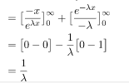

Slide 44

The Standard Deviation of the distribution –

Slide 45
GATE CS 2021
The lifetime of a component of a certain type is a random variable whose probability density function is exponentially distributed with parameter 2. For a randomly picked component of this type, the probability that its lifetime exceeds the expected lifetime (rounded to 2 decimal places) is ____________. (A) 0.37 (B) 0.25 (C) 0.50 (D) 0.18
Answer: (A)

Slide 46
Example – Let X denote the time between detections of a particle with a Geiger counter and assume that X has an exponential distribution with E(X) = 1.4 minutes. What is the probability that we detect a particle within 30 seconds of starting the counter?

Slide 47
A mobile conversation follows a exponential distribution f (x) = (1/3)e^{-x/3}. What is the probability that the conversation takes more than 5 minutes? a) e^{-5/3} b) e⁻¹⁵ c) 5e⁻¹⁵ d) e⁻⁵/3
Answer: (a)

Slide 48
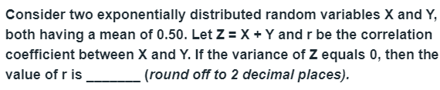
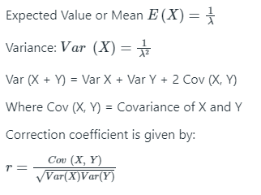
GATE ME 2020
Answer: (-1)
Notes:
P(X>a) = e^(-1/alpha) P(Z>a) = P(X>a) P(Y>a)

Slide 49
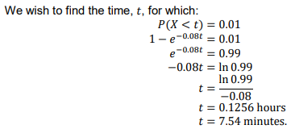
A monitor issues a warning signal when an action is needed as part of a production process. The interval, 𝑋 hours, between successive signals follows an exponential distribution with parameter 0.08.
Following a warning signal, what is the longest time the production process could be left unsupervised whilst ensuring the probability of missing the next signal is less than 0.01?
Answer: (7.54)
Notes:
P(X>a) = e^(-1/alpha) P(Z>a) = P(X>a) P(Y>a)

Slide 50

Thank you

